Slide 1
Courier Service Management
PROJECT PROPOSAL
The next step in delivery

Slide 2
Courier Service Management
Consultant
Instructor
MD.Moshaidul Islam
WDPF
IsDB-BISEW IT Scholarship
Email: moshaidul@gmail.com
Farhan Akter Lucky
WDPF
IsDB-BISEW IT Scholarship
Email: farhanawdpf@gmail.com
Submitted By
Mahidul Kabir
Trainee ID:1288235
Batch: WDPF/NCLC-M/65/01

Slide 3
Table of contents
Name of the content | Page
Application | 04
Introduction | 05
Objective | 06
Features | 07
ERD | 08
Project Timelines | 09
Resource & Technology | 10
Page Demo | 11

Slide 4
Application
08 Aug 2025
The Consultant WDPF, IDB-BISEW IDB Bhaban Sher-e-Bangla Nagar, Dhaka.
Subject: Project proposal letter for a courier service management web app
Dear Sir,
Thank you for offering me a great opportunity to make a real-life project based on our core course that is Web Development with PHP and Framework (WDPF). In this respect, I would like to inform you that I have decided to make courier service management web app , which is of most importance for every business community. I have studied the various aspects of this system and made a proposal accordingly, which is enclosed herewith for your kind perusal. So, I think you will finally approve the project and help to utilize my creativity.
Sincerely, Mahidul Kabir
Trainee ID: 1288235 Batch: WDPF/NCLC-M/65/01 Round: 65

Slide 5
Introduction
In today's fast-moving world, courier services play a key role in helping people and businesses stay connected. Whether it's delivering a package across the city or sending products to customers, reliable delivery is now a basic expectation. However, many small or mid-level courier services still use manual systems that are slow, confusing, or prone to errors. This project proposes a web-based application for managing courier services more efficiently. The system will make tasks like booking, tracking, and managing deliveries easier for both customers and admins. It aims to reduce paperwork, improve delivery speed, and ensure better communication between users and service providers. With features like order tracking, real-time status updates, and digital records, the application will help courier companies take the “next step” in modern delivery services. The goal is to make courier operations smoother, faster, and more reliable using simple, user-friendly technology.

Slide 6
Project Objective
The main objective of this project is to develop a simple and efficient web-based courier management system. It will help users book deliveries, track shipments in real-time, and manage orders digitally. The system will also support admin features like updating delivery status, managing users, and organizing records. By reducing manual work and increasing speed and accuracy, the application aims to improve customer satisfaction and support smoother courier operations. Overall, the goal is to bring convenience, reliability, and transparency to the courier service process.

Slide 7
Features
Real Time Tracking
Complaints and Suggestions
Customer will be able to track every step of the delivery through order id online. They will know exactly in which step their parcel actually is.
Customer can put their complaints or suggestion against the service they requested. The complaints will be addressed directly by the admin.
Delivery Management
Financial Management
Total delivery process is managed through a meticulous admin panel which is easy to use and branch employee will handle it.
The delivery cost of each parcel will be dynamically put as per the weight and risk category of the parcel. The admin will be able to see the earnings easily in the admin panel.
And many more….

Slide 8
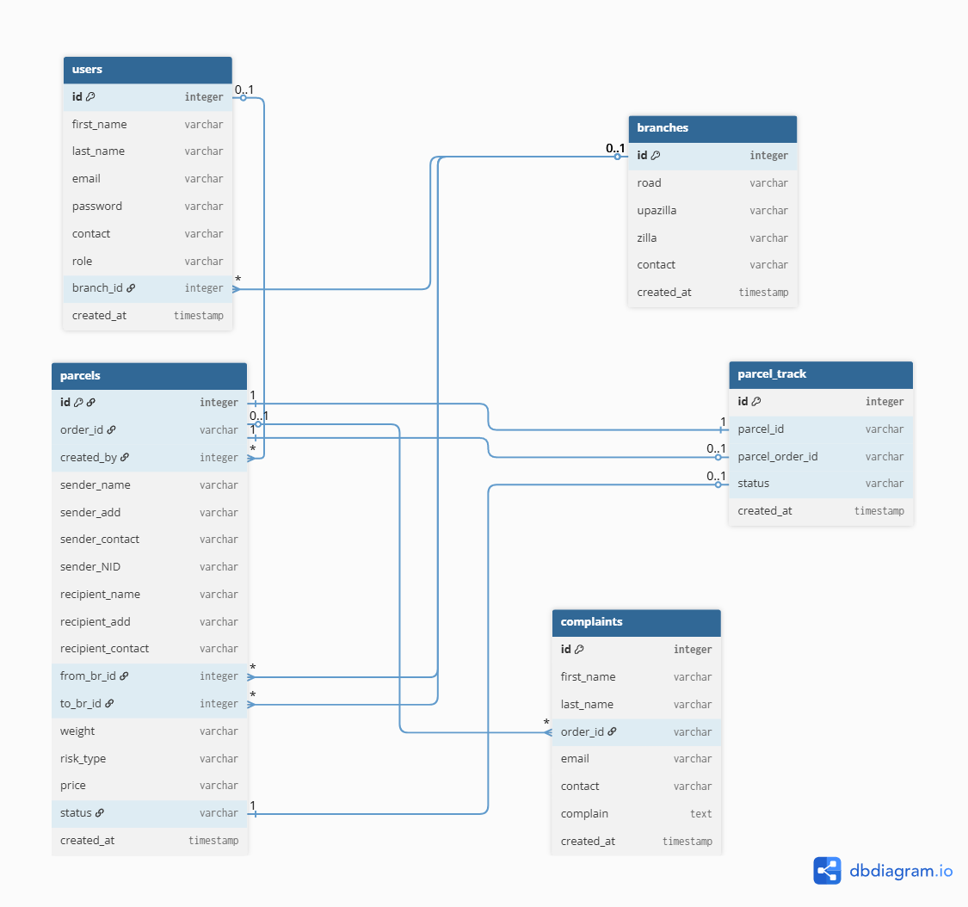
ERD – Entity Relationship Diagram

Slide 9
Project timeline
Initial Study & Documentation
7 Days
Feasibility Study & Documentation
5 Days
Design and Wireframing
10 Days
Front-end Development
8 Days
Back-end Development
15 Days
Testing and Quality Assurance
10 Days
Deployment and Launch
7 Days
Project Completion and Handover
4 Days

Slide 10
Resources & Technology
Frontend | Html 5, CSS3, Bootstrap, JavaScript
Back end | PHP, MYSQL
Server Hardware Configuration
Processor | Intel(R) Core(TM) 2Duo CPU @ 2.93 GHZ
RAM | 2 GB
Hard Disk Drive | 20 GB
Keyboard | 122 Keys
Server Software Configuration
Operating System | Windows 7 and higher
Language | PHP
Database | MYSQL
Operating System | Windows 7 and higher

Slide 11
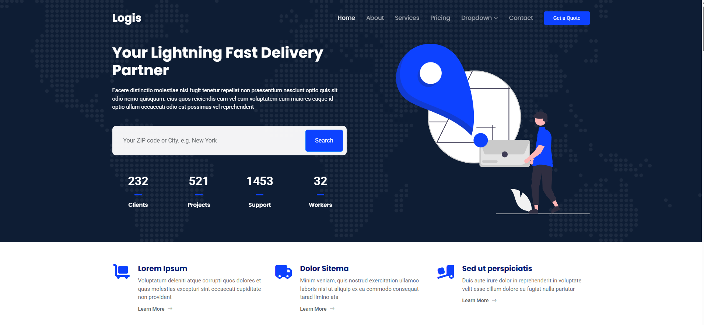
Landing Page

Slide 12
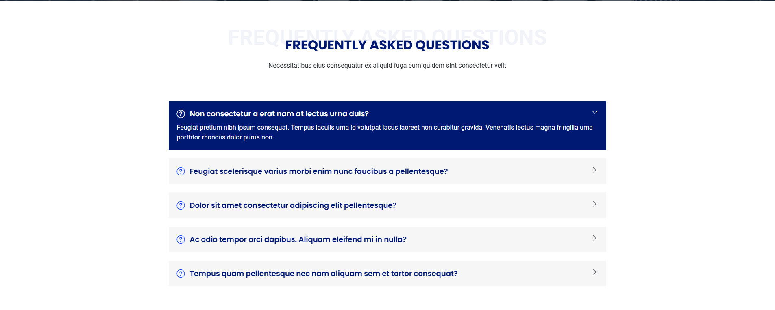
FAQ Section

Slide 13
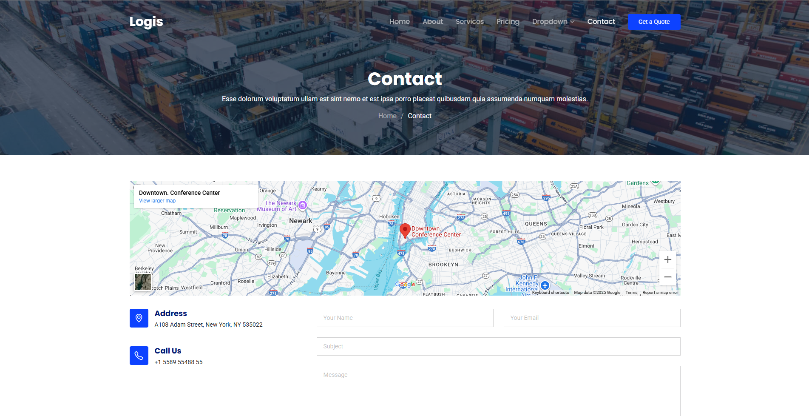
Contact Us Section

Slide 14
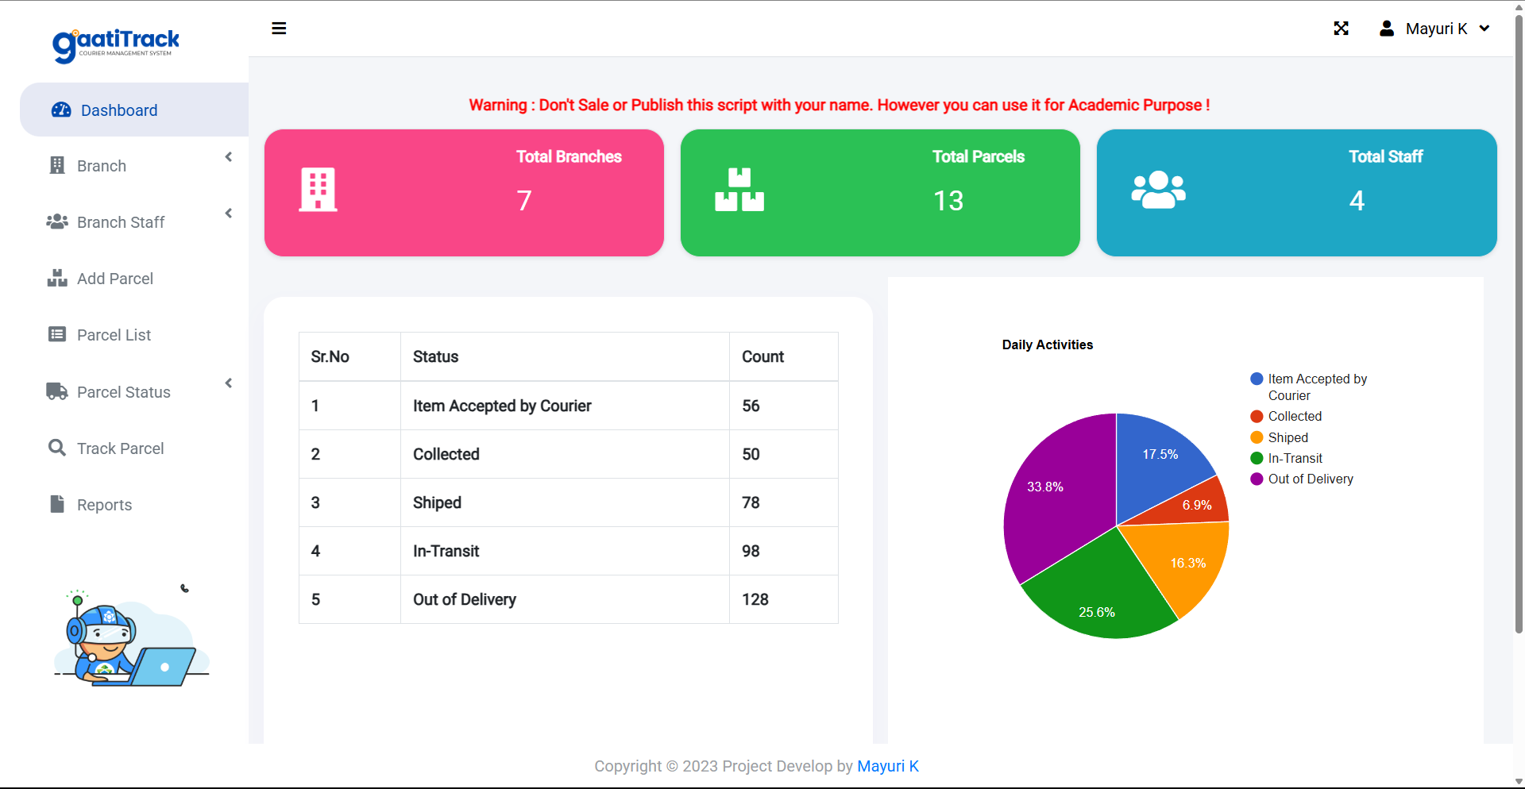
Admin Panel

Slide 15
Thanks!
ALT
Free PSD | Flat design luxury men’s fashion instagram posts (freepik.com)
Do you have any questions?

